Slide 1


Slide 2
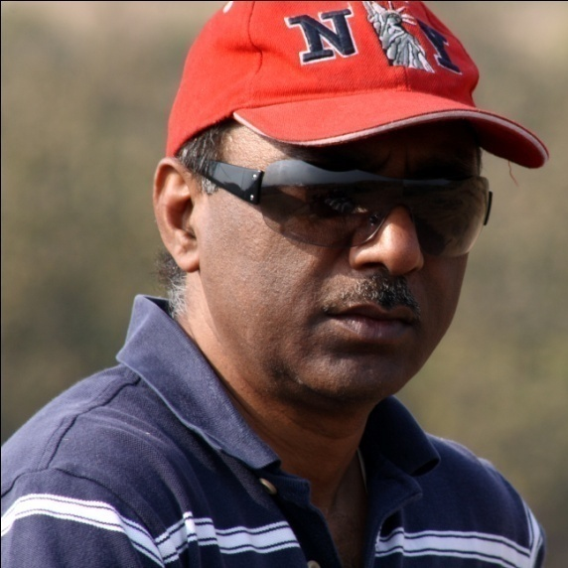
PRODUCER- ASHOK PANDEY
Chairman & CEO, Revel Films
Successful Entrepreneur having built and
run a Multinational IT business
BE (EEE) – BITS Pilani, MS (Comp Sc) – USA
Produced PHAS GAYE RE OBAMA (2010)
SAARE JAHAAN SE MEHNGA (2013)

Slide 3






PHAS GAYE RE OBAMA – Released 2010

Slide 4
Now Producing.. “BACH GAYE RE OBAMA”
Tentative Title Bach Gaye Re Obama
Producer Ashok Pandey
In assoc. with Akashdeep [Cinetek]
Director Ashish Mohan
Writer Danish Hussain
Genre Comedy
Locations India + US
Potential Cast Arshad Warsi/Boman Irani
Sanjay Mishra, Manurishi Chadda
Aditirao Hydari
Shooting starts February 2015
Completion June 2015
Tentative budget 14 Crores
[subject to final casting approved by corporate]

Slide 5


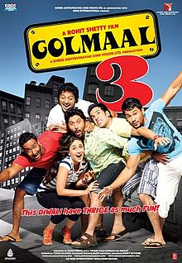

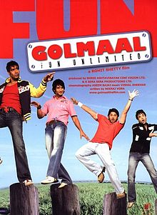

BACH GAYE RE OBAMA
ASHISH MOHAN
Director
BRIEF HISTORY
Director – Welcome to Karachi starring Irrfan Khan, Arshad Warsi
Director - KHILADI 786
AD and Chief AD
Golmaal 3
Golmaal Returns
Golmaal
All the Best
Sunday
Blackmail

Slide 6
BACH GAYE RE OBAMA – Draft Synopsis
Bach Gaye Re Obama (BGRO) is a sequel to the hit film Phas Gaye Re Obama (PGRO). BGRO is a fast paced, fun-filled , hilarious gangster based satirical comedy, larger in scale and scope than its prequel. The story deals with the problems faced by a maid who is ‘used’ by the powerful diplomats abroad and how her challenging their might shakes the corridors of power both in India and the US.
The story has four main characters – Sheetal, Chaddha, Bhaisaab and Anni.
Bhaisaab is an MP while he still runs his broke gang under-cover. Anni is his right hand hunchman who is disillusioned from his time in PGRO where he misses the chance to go to America.
Sheetal, is an aspiring ambitious middle class girl working at a beauty salon. Her aspirations to go to America gets her in contact with Chaddha, an agent who places people abroad. Chaddha falls for Sheetal the moment he sees her and decides to help her. Chaddha gets entangled with Bhaisaab and gang when he tries to fleece Anni who has been promised a US job. But when Anni finds out that he is being ‘shipped’ to Botswana, he comes after Chaddha with all his ‘Gang’ and their might.. Chaddha is caught by the Gang and is being brutally handled. Upon realizing the gravity of the situation with the Gang he offers Bhaisaab an idea (akin to the idea in Phas Gaye Re Obama) that could make them all rich.. Bhaisaab likes the idea of a ‘cleaner’ highly-profitable business and together they go into business.. With the help of Bhaisaab and his MEA contacts he gets Sheetal placed as a maid with a diplomat to help his wife cook and take care of their kids. She is overjoyed and dreams to make it big in America!
The whole havoc starts when Sheetal reaches the US and realizes how ill-treated and overworked she was! Her dreams get shattered and she revolts..This pivotal event takes the rest of the film on a roller-coaster ride of fun, laughter, emotions and satire on the political diplomacy.. from kidnapping, blackmailing arm-twisting in India to the Indian Govt to US Govt level mud-slinging, name-calling, arm-twisting that finally culminates into a climax that is historic, with the US Govt bowing down to Indian Govt. demands (BACH GAYE RE OBAMA!) - all thanks to a maid – Sheetal, not to mention her becoming a US Permanent Resident!

